Slide 1
E
I
Ț
I
T
S
E
V
Ă
N
T
I
A
M
O
T
U
A
A
L
Ă
S
R
U
B

Slide 2
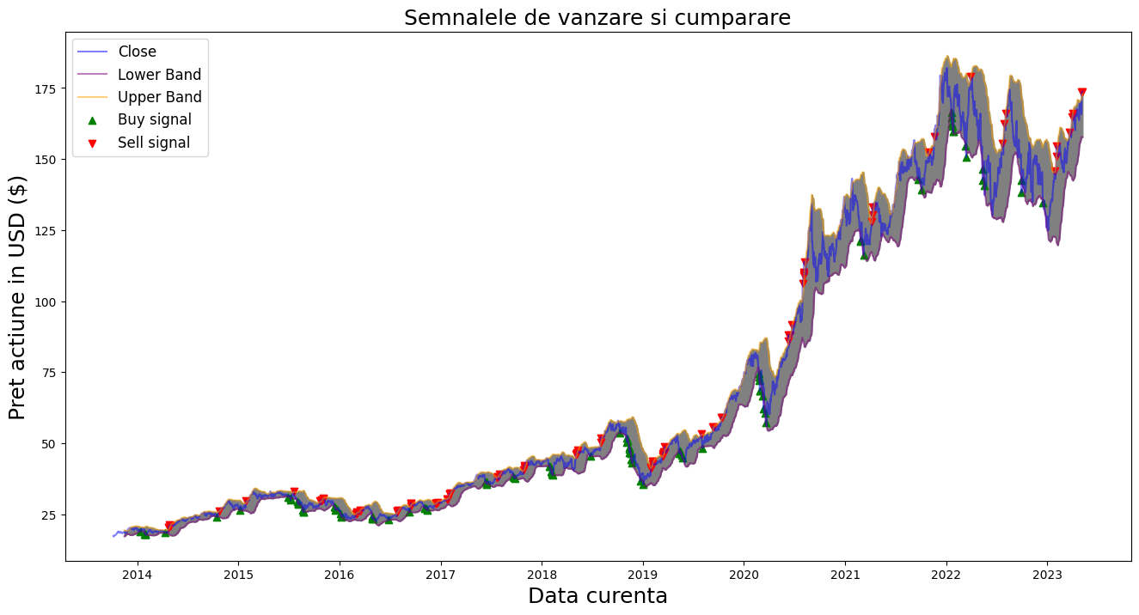
BUY
SELL

Slide 3
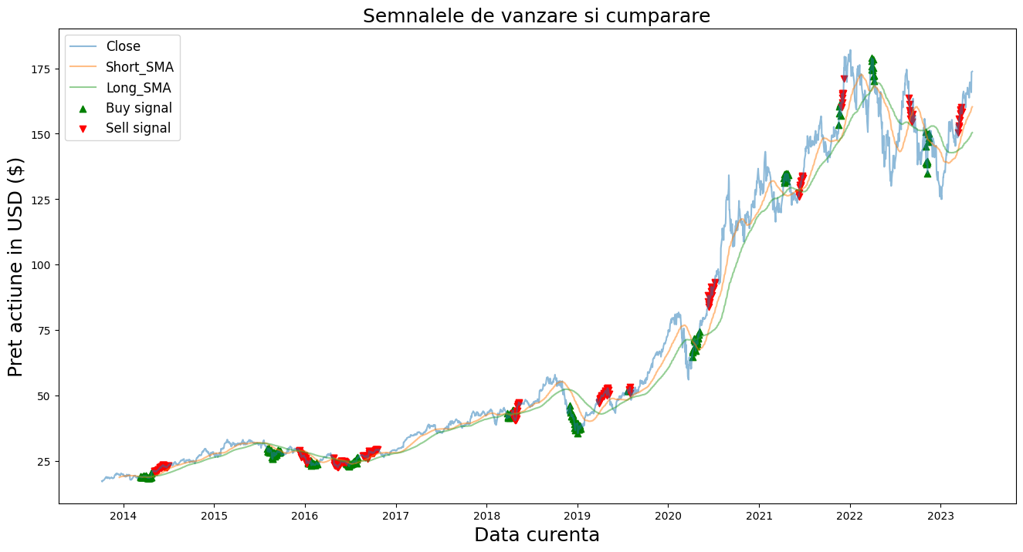
BUY
SELL

Slide 4
BUY
SELL
CONTENTS
CONTENTS

Slide 5
Infographic Style
Your
Text Here
You can simply impress your audience and add a unique zing and appeal to your Presentations.
Your
Text Here
You can simply impress your audience and add a unique zing and appeal to your Presentations.
Simple Portfolio Presentation
Presentation
Portfolio
Simple Portfolio
Portfolio Presentation
Presentation

Slide 6
Fully Editable Shapes
BUY
SELL
BUY
SELL

Slide 7

Fully Editable Shapes And PNG
I
M
V
E
S
T
I
L
O
S
S
K

Slide 8
Fully Editable Icon Sets: A

Slide 9
Fully Editable Icon Sets: B

Slide 10
Fully Editable Icon Sets: C

